Slide 1
Calculator App Development
Siddhant Zawar
Tools and Technologies: Springboot, Jenkins, Docker
This presentation outlines the development process for a calculator app using Springboot, Jenkins, and Docker. The project involved creating a Springboot application, setting up a Jenkins pipeline for continuous integration and deployment, and building a Docker image for containerization.

Slide 2
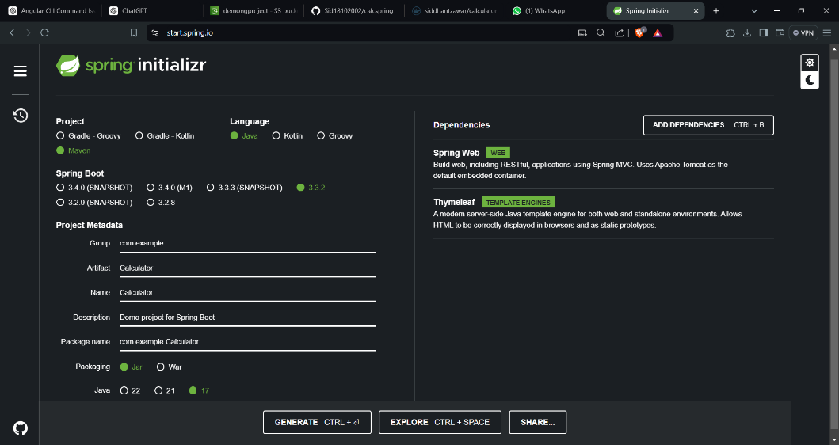
Springboot Project Setup
1. Created initial springboot maven project zip.

Slide 3
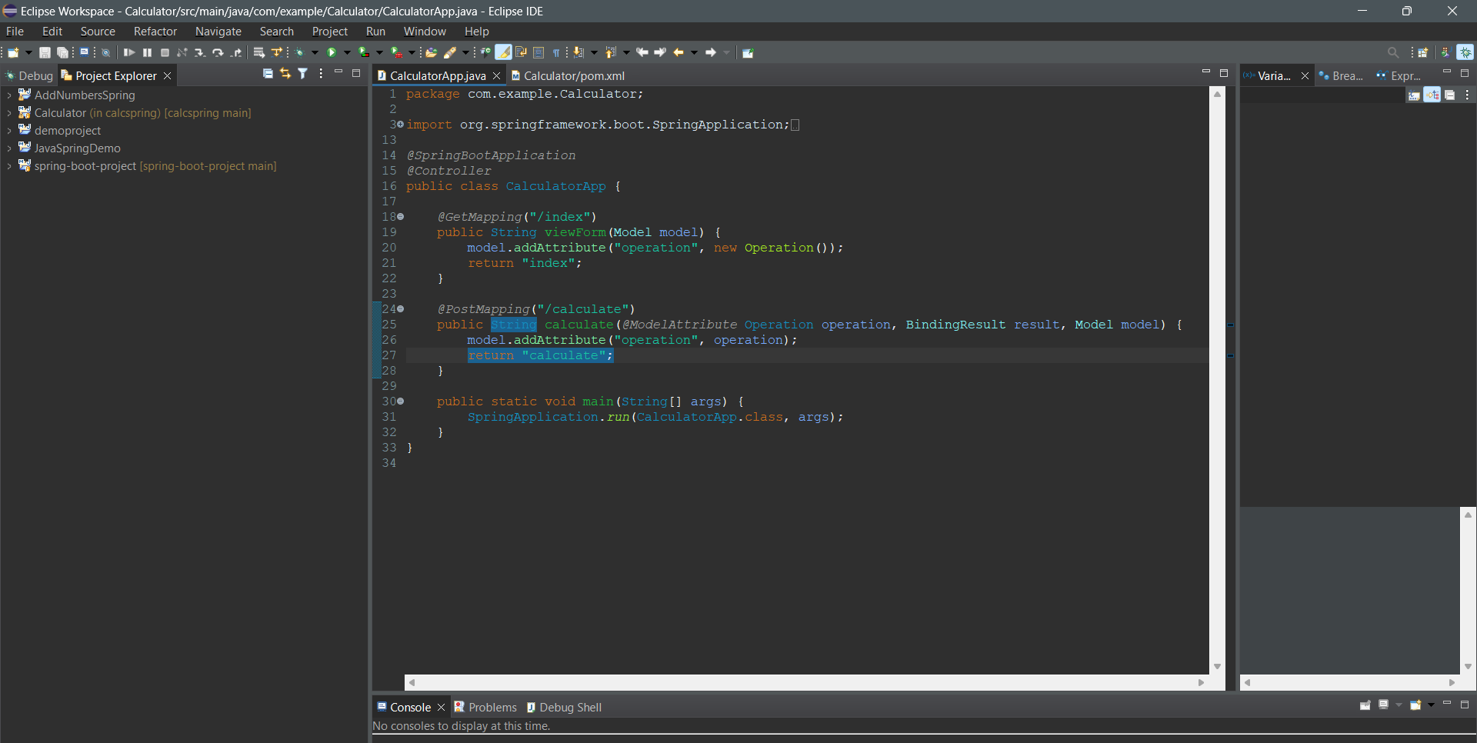
Springboot Project Setup
2. Importing Maven project to Eclipse

Slide 4
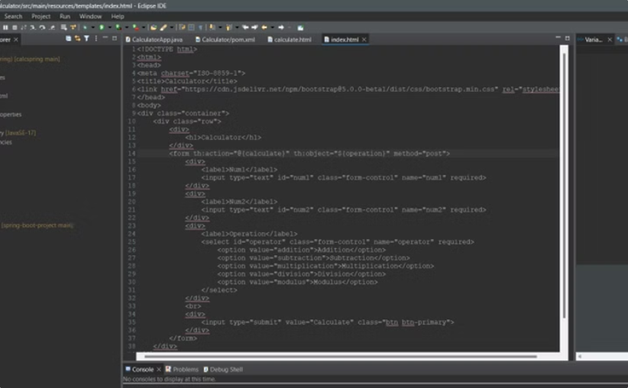
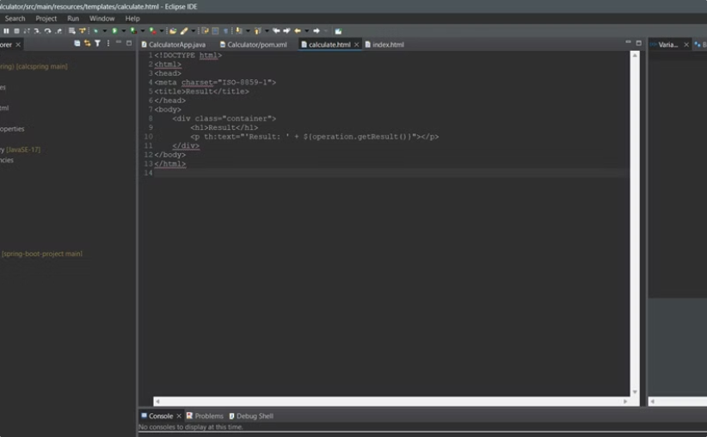
Calculator App Interface
Index.html
Calculator.html
The index.html file provided the main landing page for the calculator app.
The calculator.html file displayed the calculator interface with input fields and buttons.

Slide 5
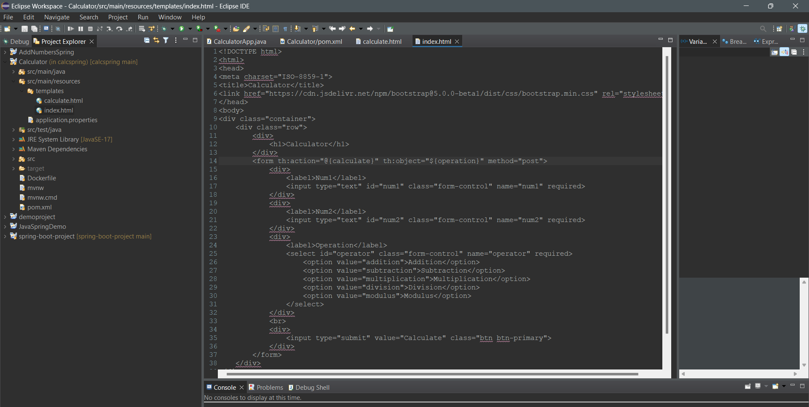
Index.html

Slide 6
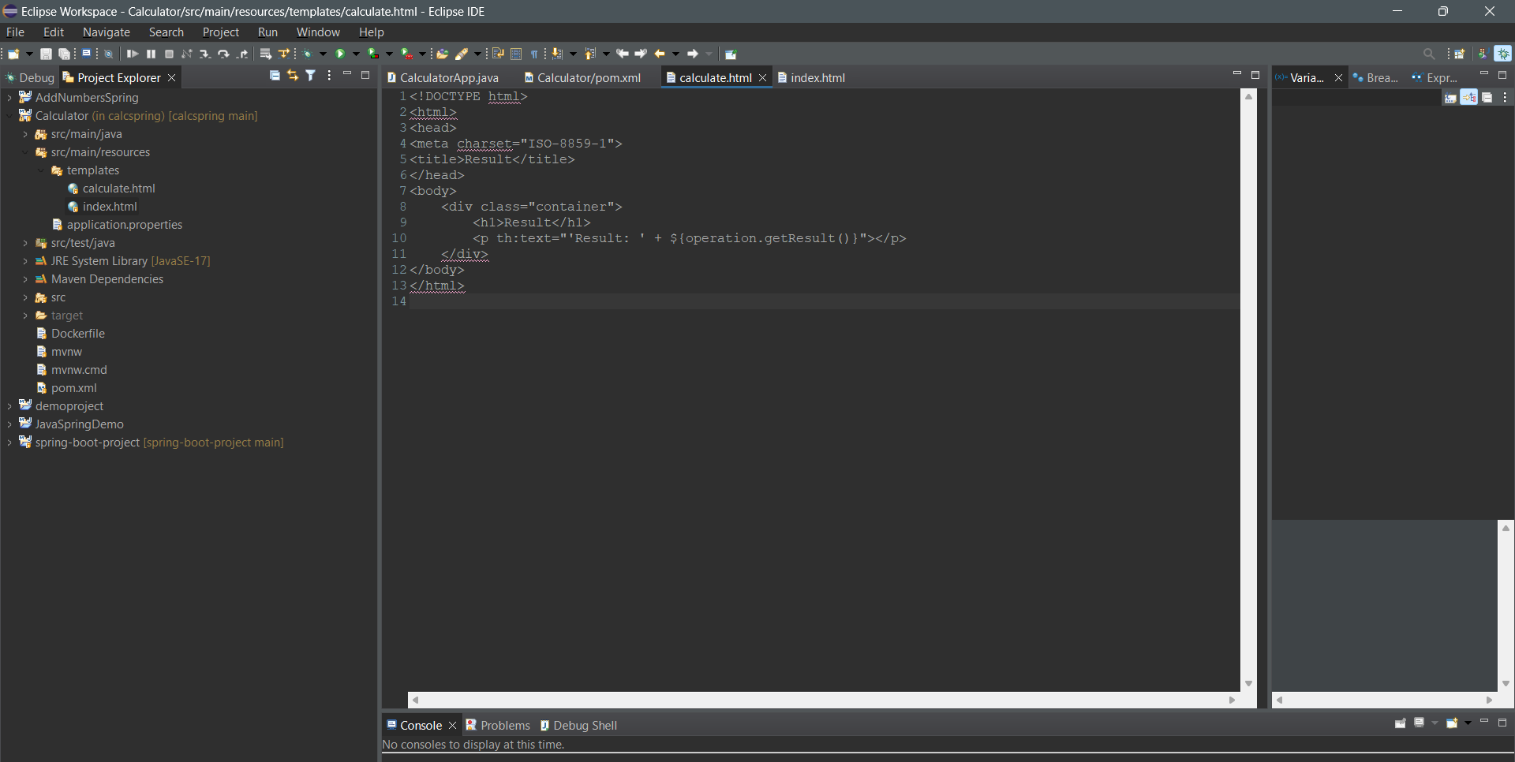
calculate.html

Slide 7
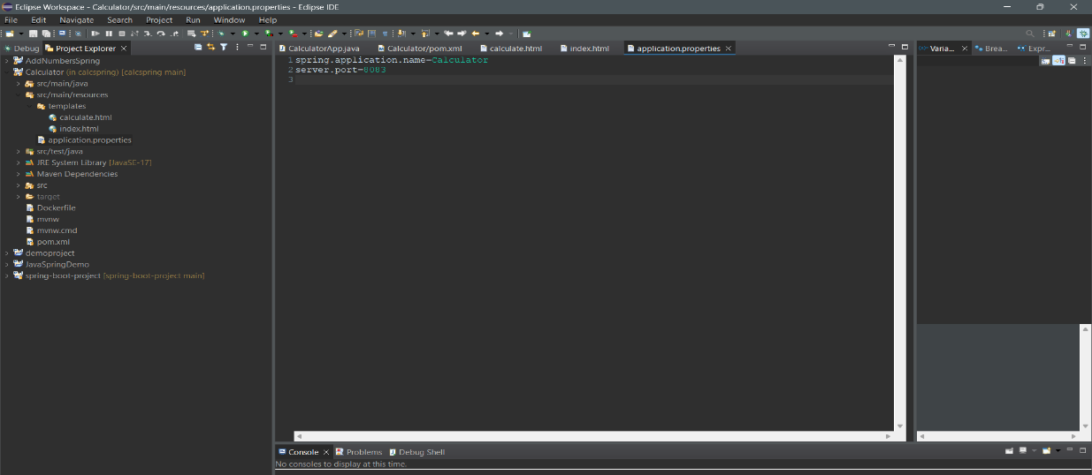
(application.properties) : Setting Server Port number

Slide 8
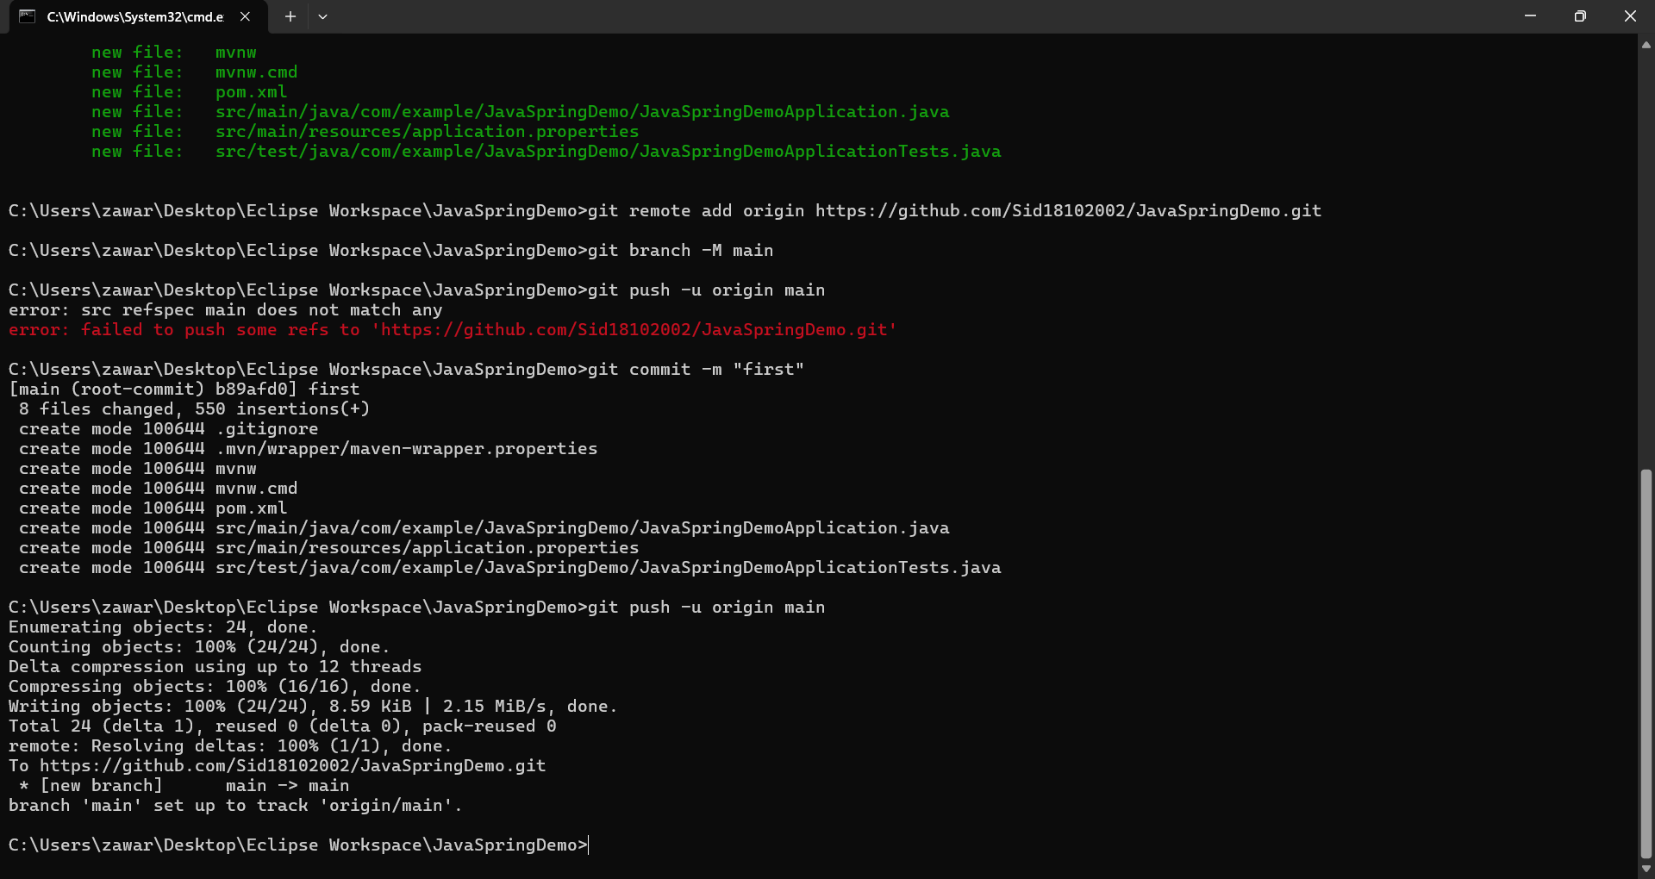
Project pushed to github:

Slide 9

Jenkins Pipeline Setup
1
Account Creation
A Jenkins account was created to manage the CI/CD pipeline.
2
Freestyle Project
A Freestyle project was selected for the Jenkins pipeline.
3
Project Configuration
The project was configured to pull code from Github, build the application, and run tests.
4
Github Integration
Github credentials were added to Jenkins to enable code fetching.

Slide 10
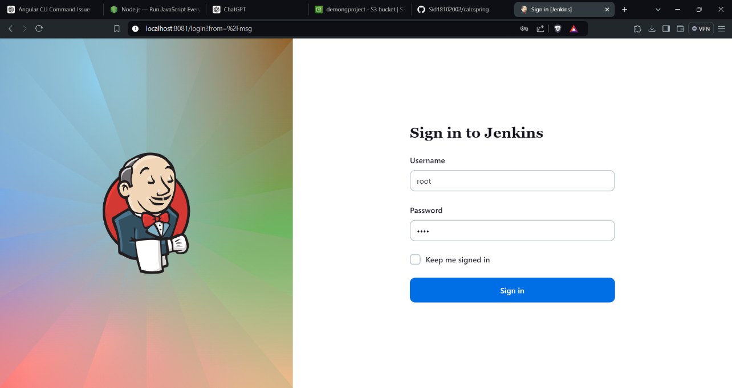
Creating Account

Slide 11
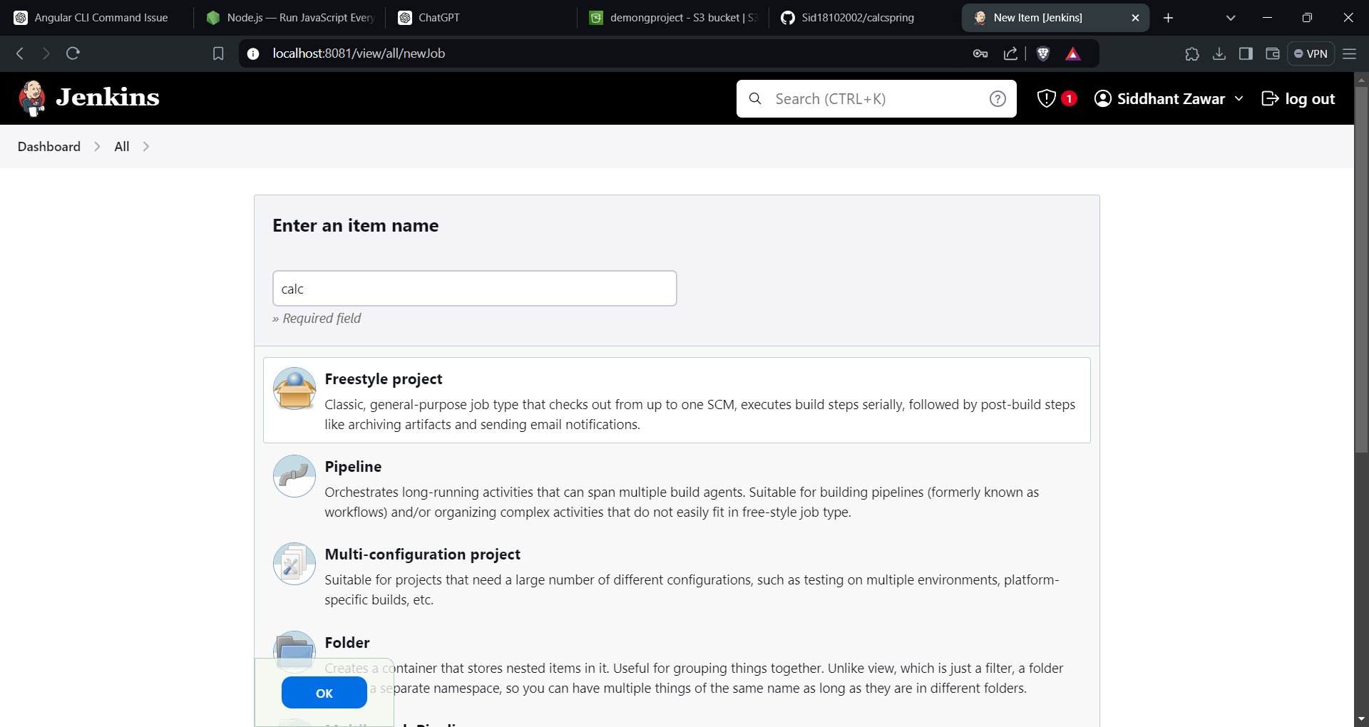
Select project type as Freestyle project

Slide 12
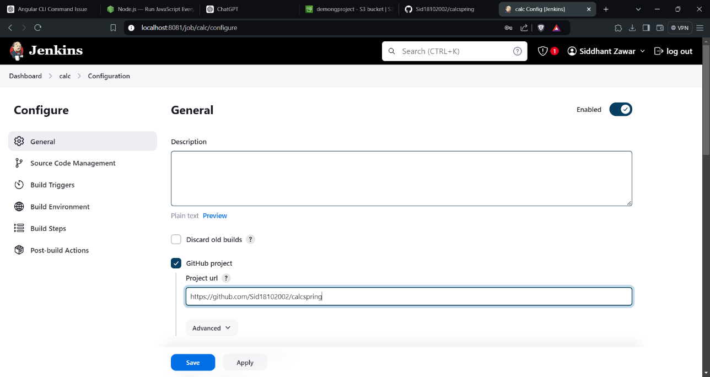
Project Configuration

Slide 13
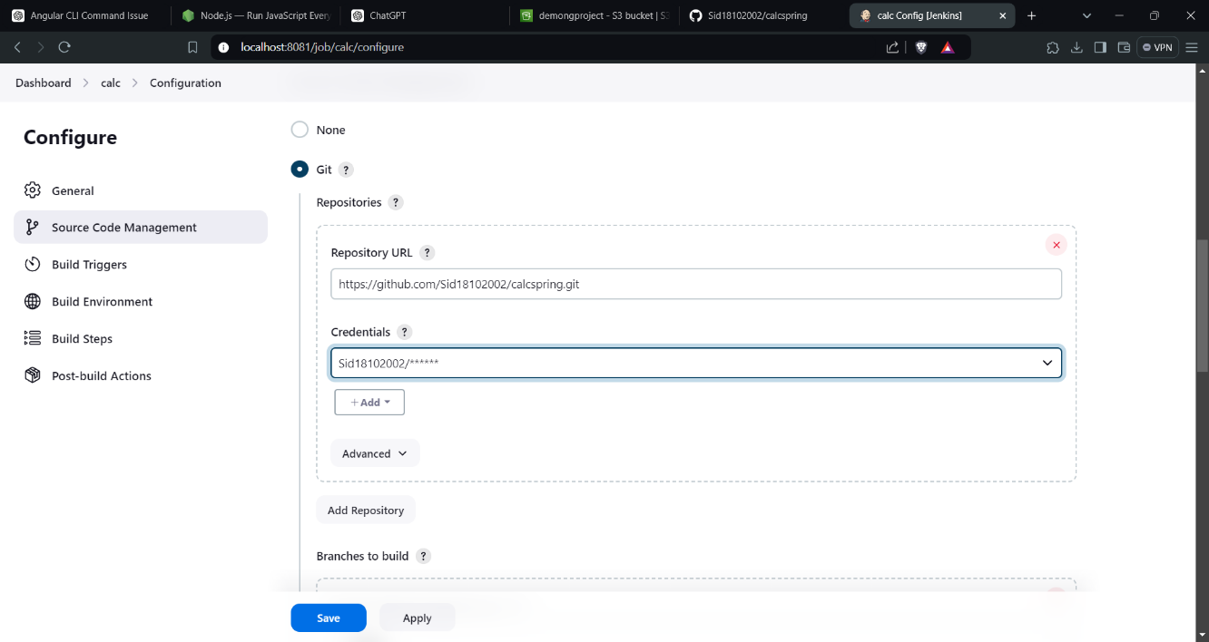
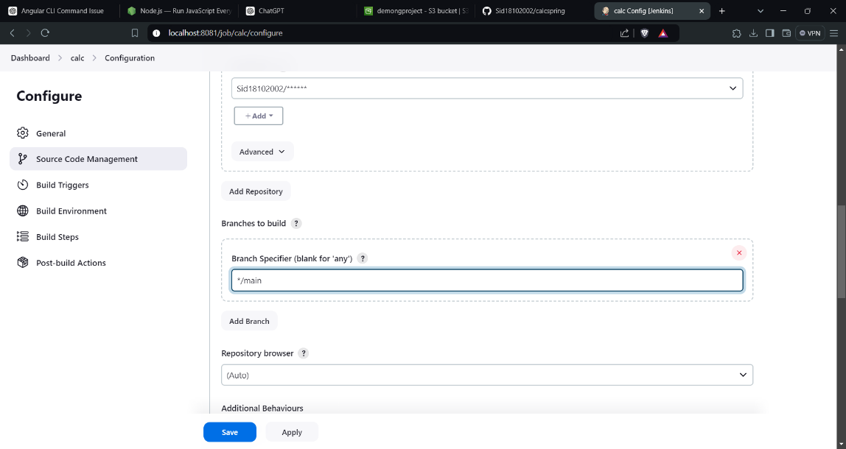
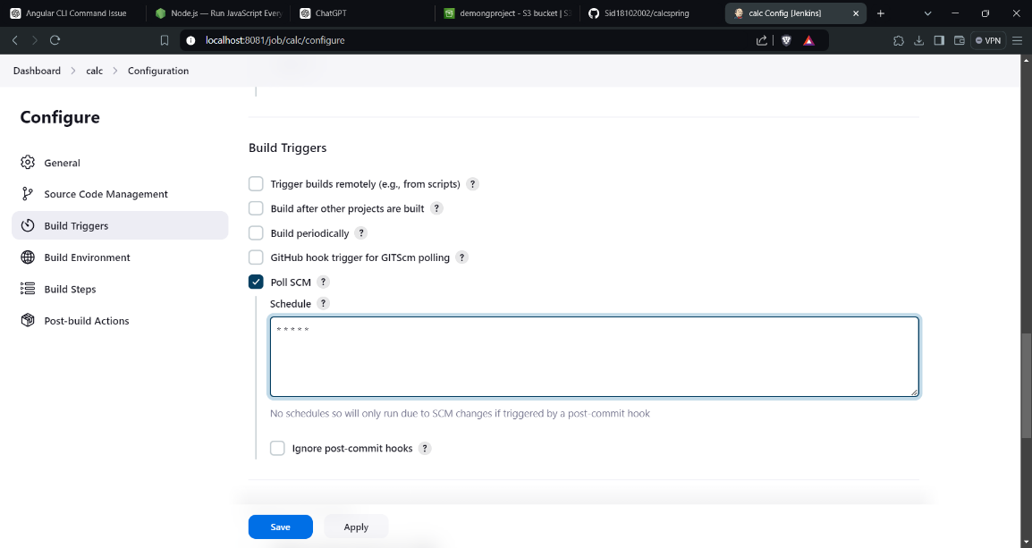
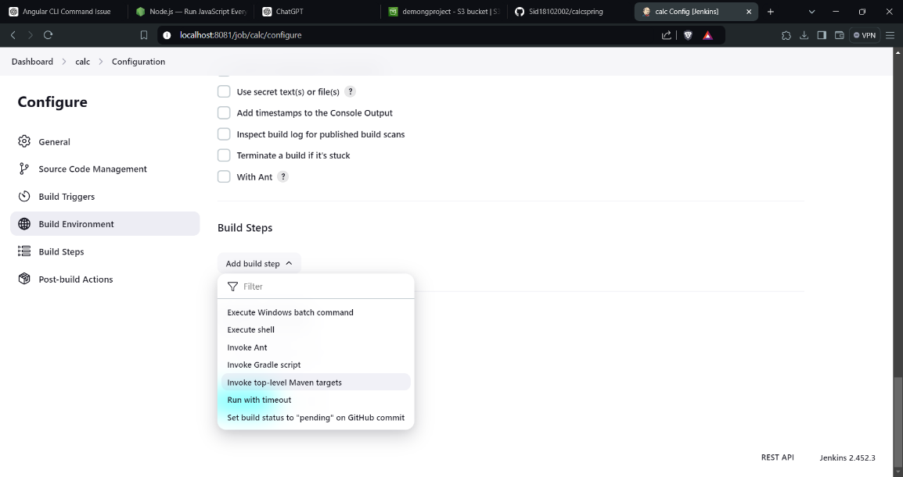
(added github details to Jenkins)

Slide 14
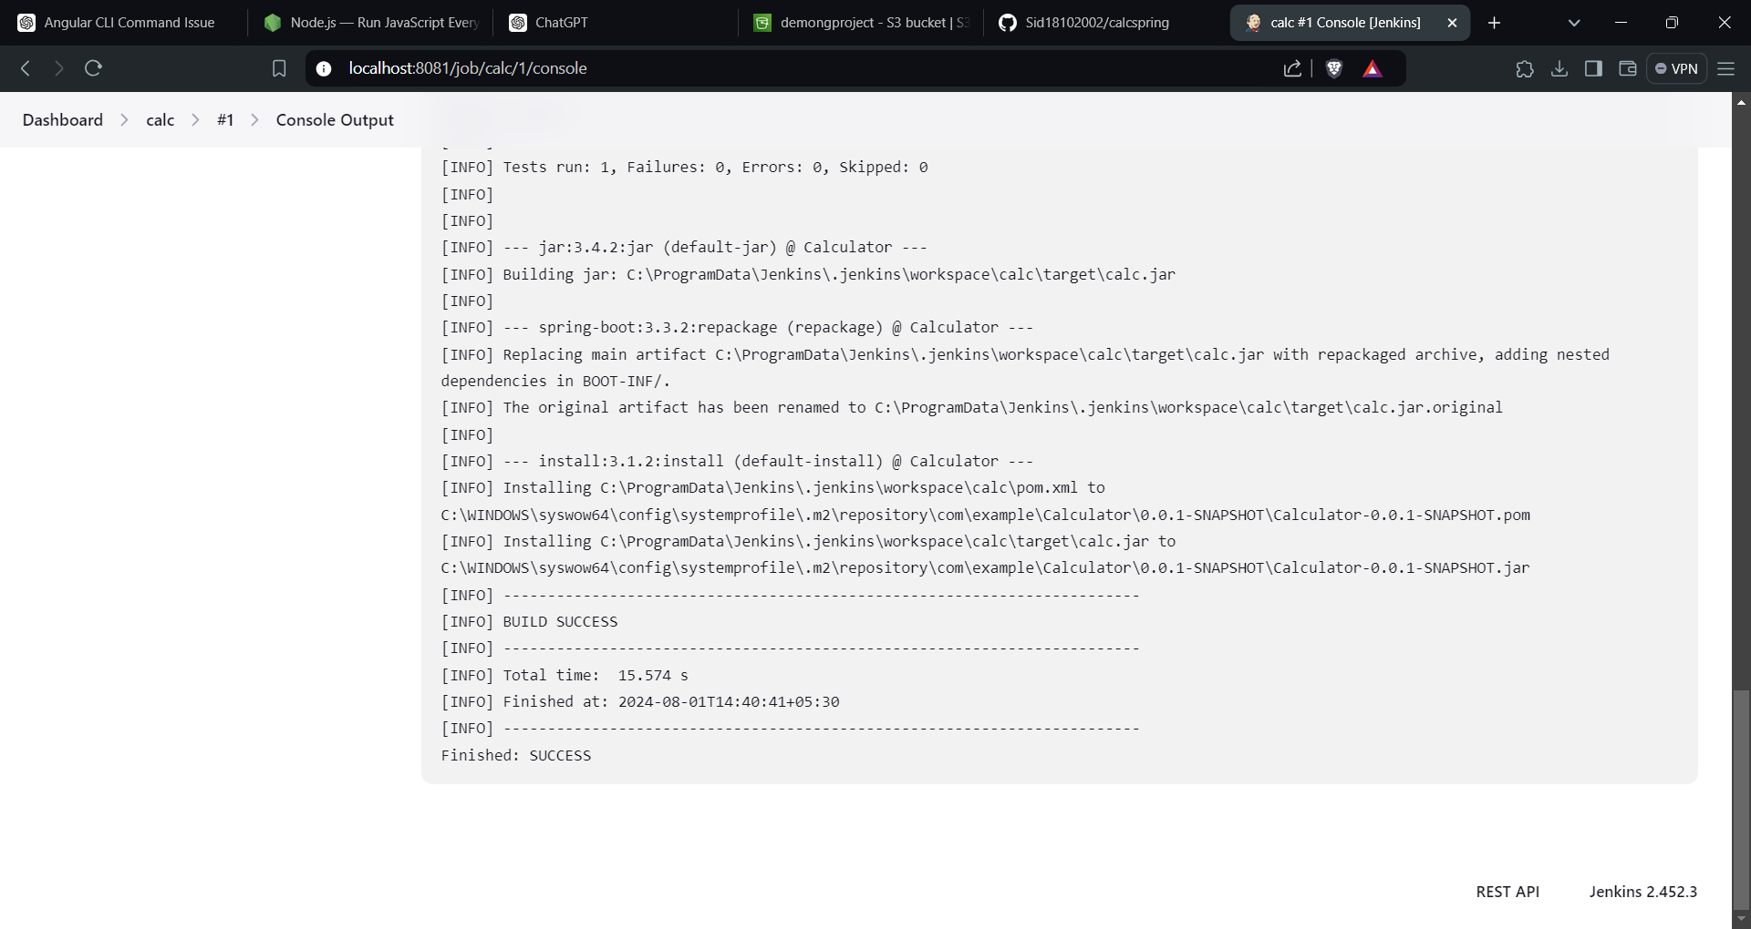
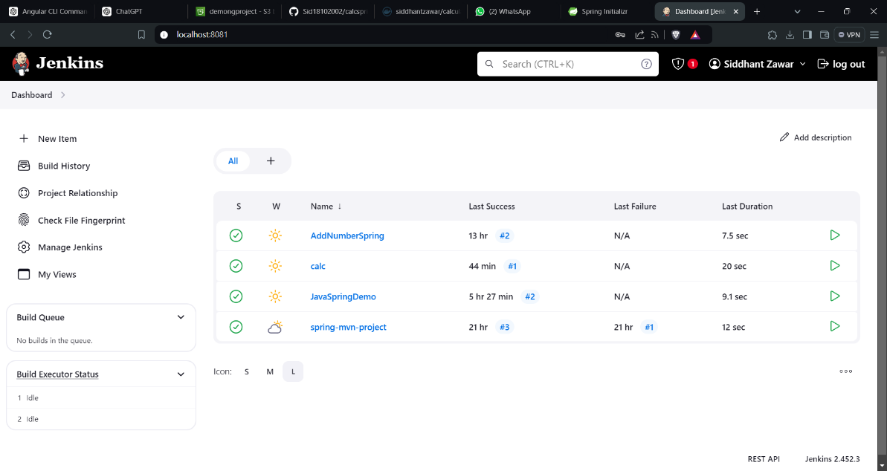
Project Build Successfully

Slide 15

JAR File Creation
Pom.xml Configuration
Dockerfile Creation
Maven Install
The pom.xml file was configured to specify a custom filename for the JAR file.
A Dockerfile was created to define the Docker image for the application.
The Maven install command was executed to build the JAR file.

Slide 16
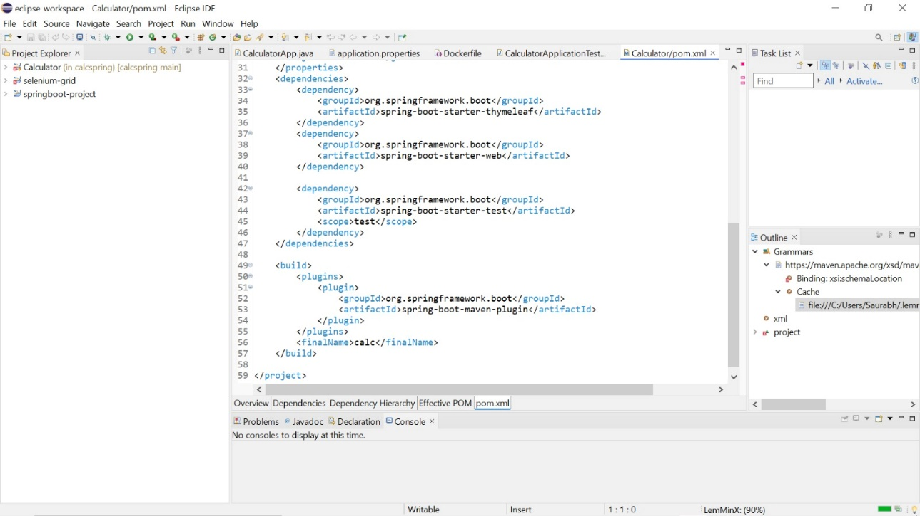
1. In pom.xml use <finalName> tag to select customized filename for your jar file

Slide 17
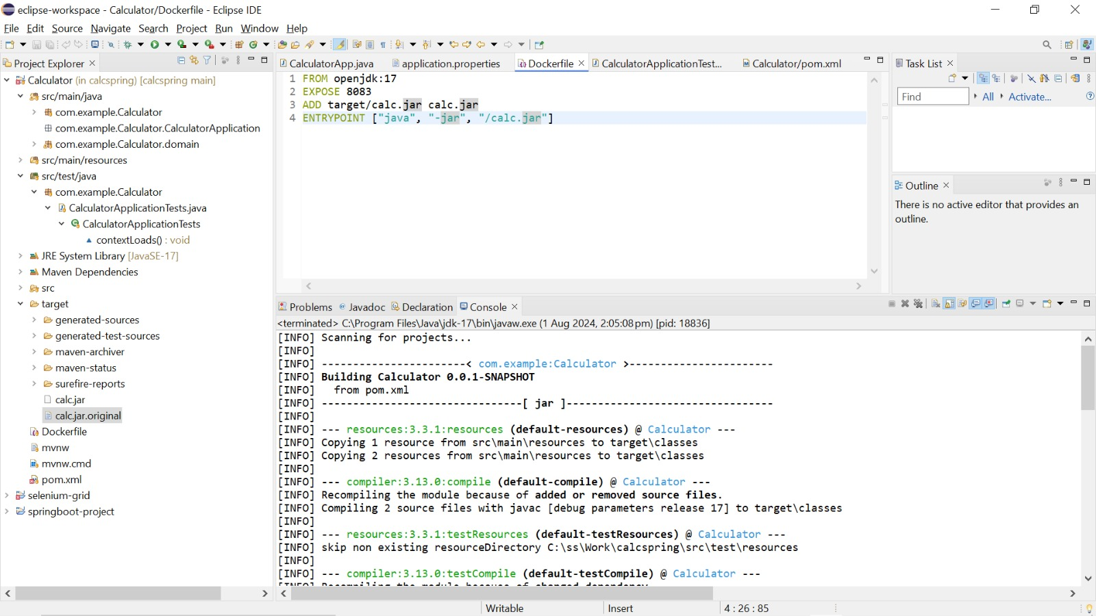
2. Create ‘Dockerfile’ in your project and insert all used dependencies in it

Slide 18
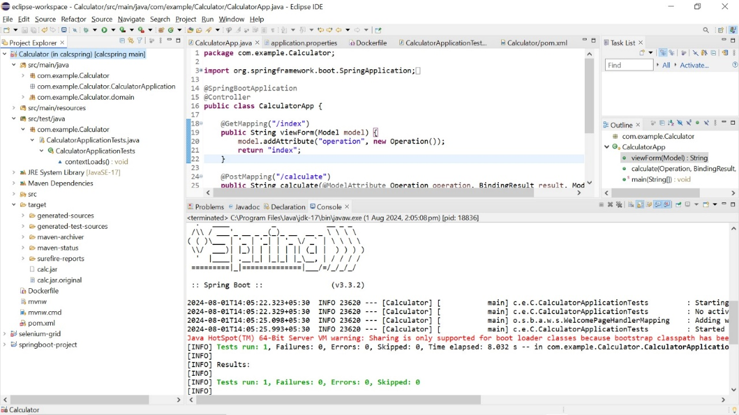
3. Then use ‘maven install’ command by right clicking project folder -> run as -> maven install

Slide 19
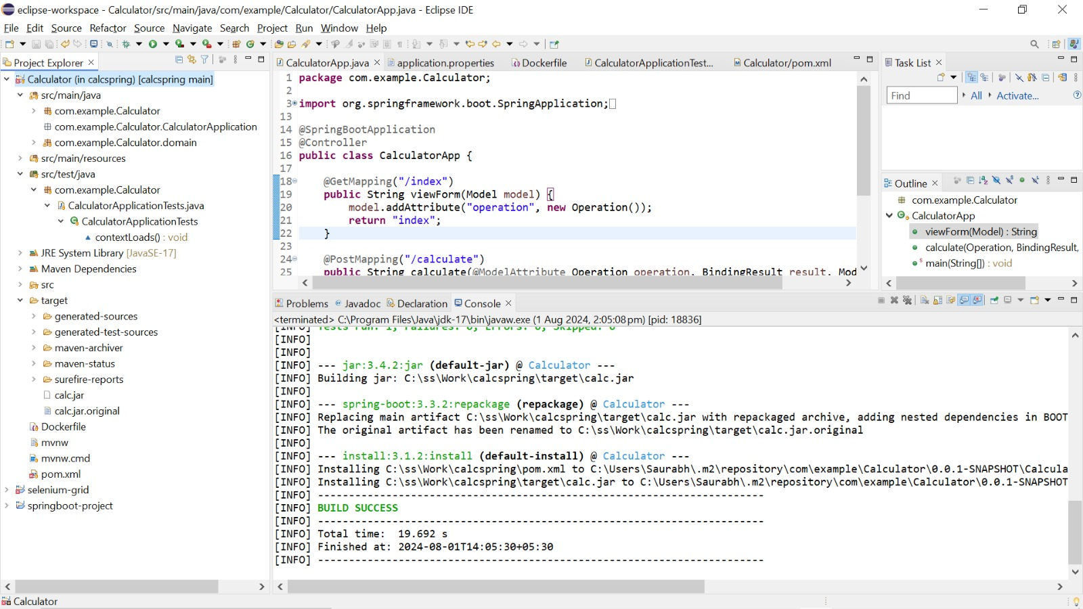
4. JAR file is created under target folder:

Slide 20
Docker Image Creation
1
Repository Creation
A repository was created on Dockerhub to store the Docker image.
2
Image Build
The Docker image was built using the Dockerfile and the JAR file.
3
Container Run
A Docker container was run from the built image, starting the application.
4
Image Push
The tagged Docker image was pushed to the Dockerhub repository.

Slide 21
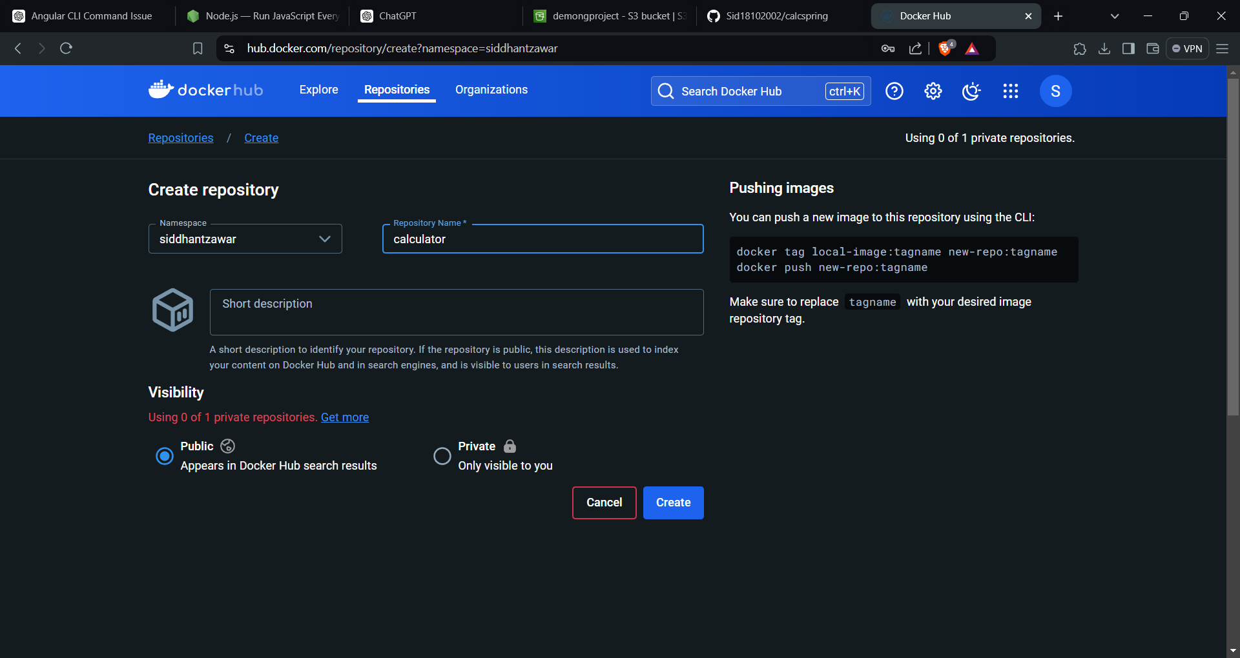
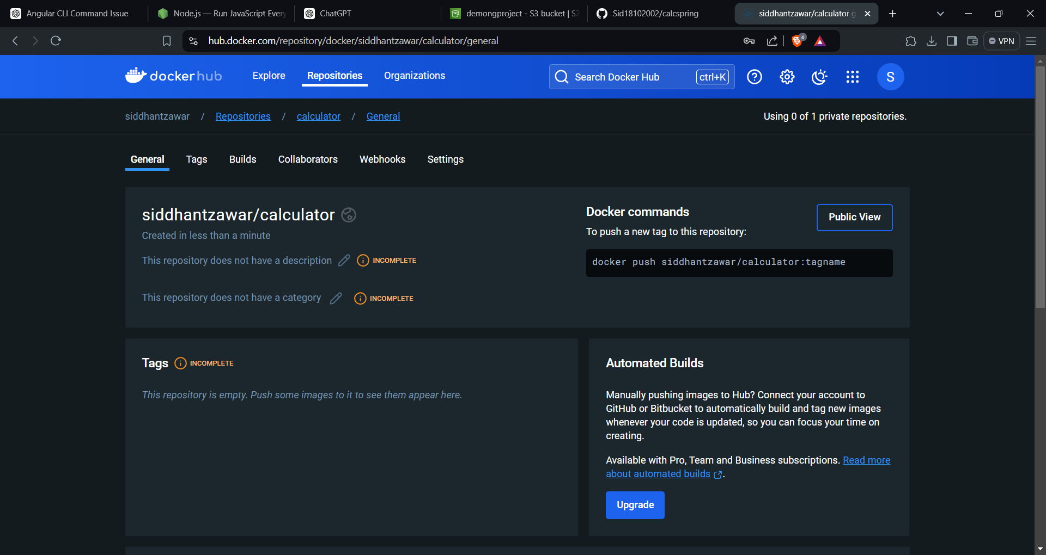
1. Created a repository on Dockerhub

Slide 22
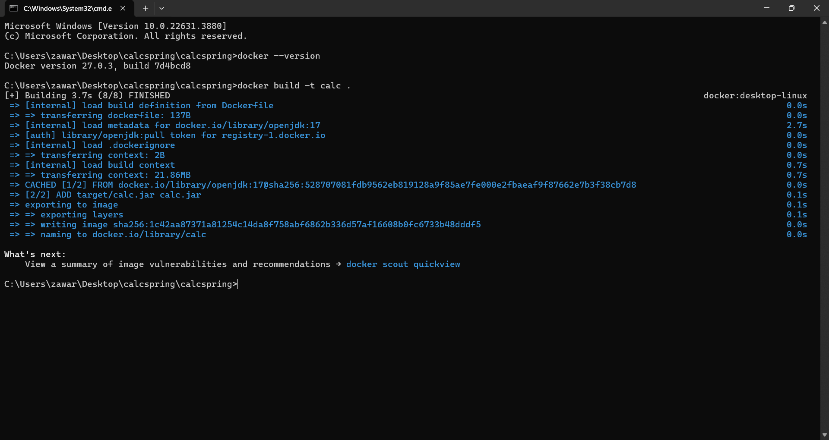
2. Built docker image

Slide 23
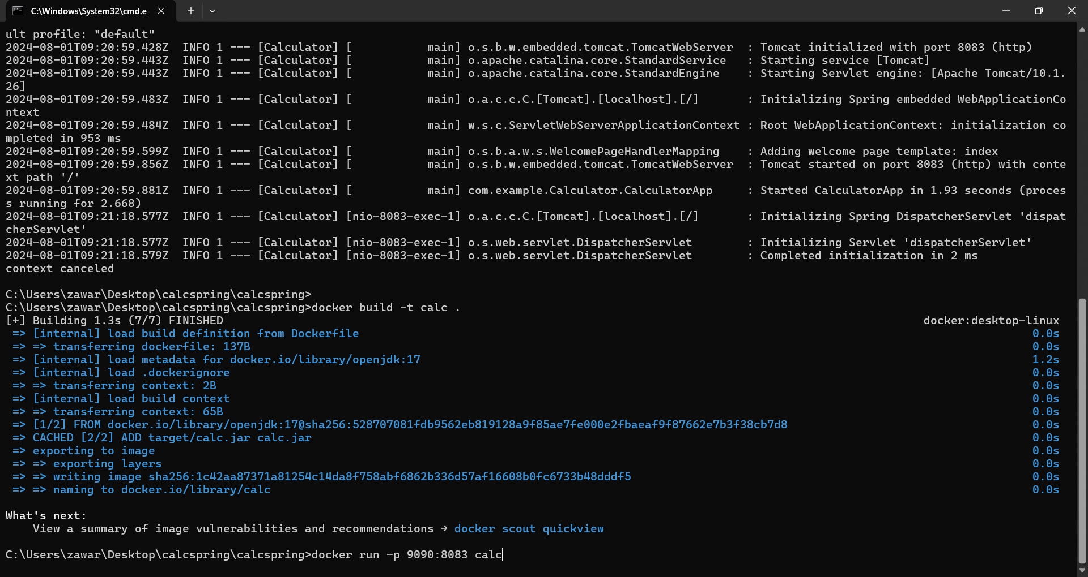
3. Running docker container from the specific image

Slide 24
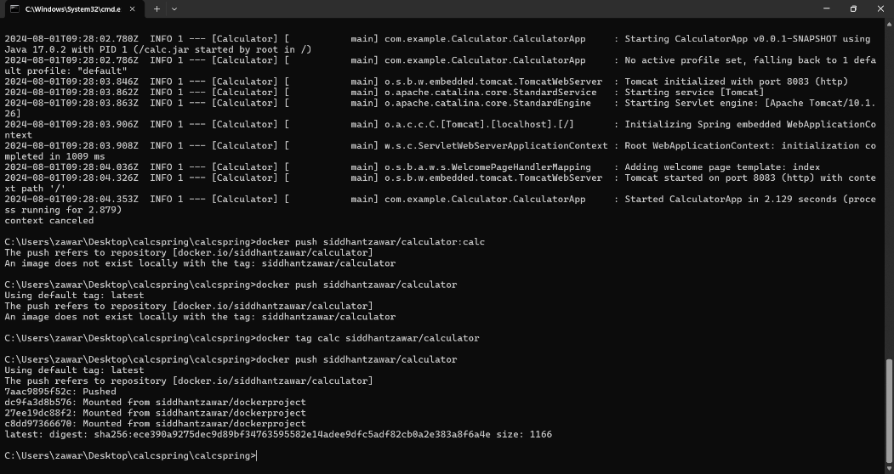
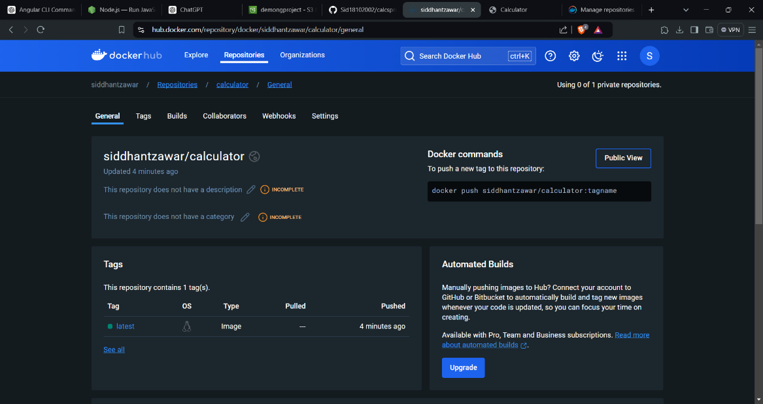
4. Pushed tagged image to docker registry

Slide 25

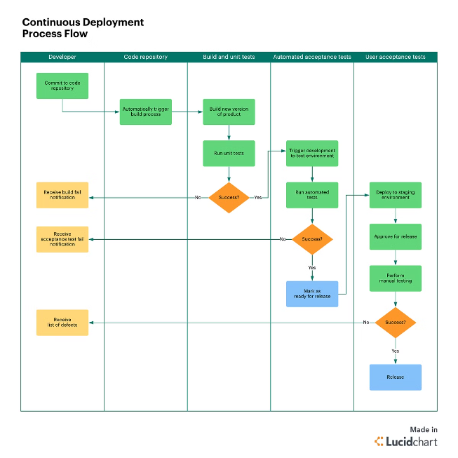
Deployment Process
Step
Description
1
Build the Docker image using the Dockerfile.
2
Push the image to the Dockerhub repository.
3
Deploy the container to a cloud platform or on-premise infrastructure.
4
Configure the application to access the database and other services.
5
Test the application to ensure it is functioning correctly.

Slide 26




Final Output
Calculator App
The final output was a fully functional calculator app, accessible through a web browser.
Cloud Deployment
The app was deployed to a cloud platform, making it accessible to users.
Continuous Integration
The Jenkins pipeline ensured continuous integration and deployment of the application.
Containerization
The Docker image enabled containerization, providing portability and scalability.

Slide 27
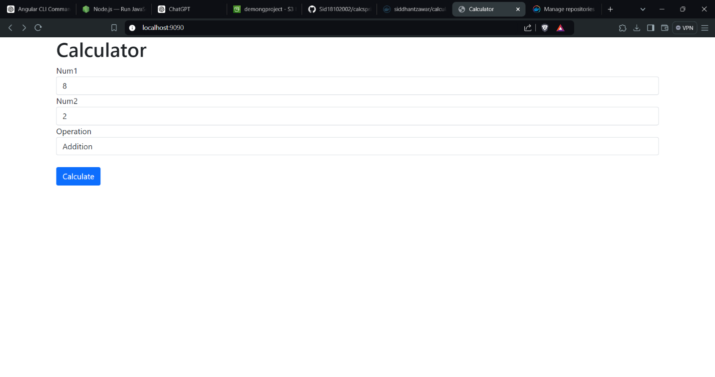

Slide 28
